Slide 1



eHealth+
eMedication
Security Penetration Test preparation Online Session
14 Nov 2024
Dr Wong Wing Nam
Mr German Leung
Logistics and Supply Chain MultiTech R&D Center (LSCM)
Mr Ricky Hui
Ms Lisa Huen
Hospital Authority, IT&HI

Slide 2


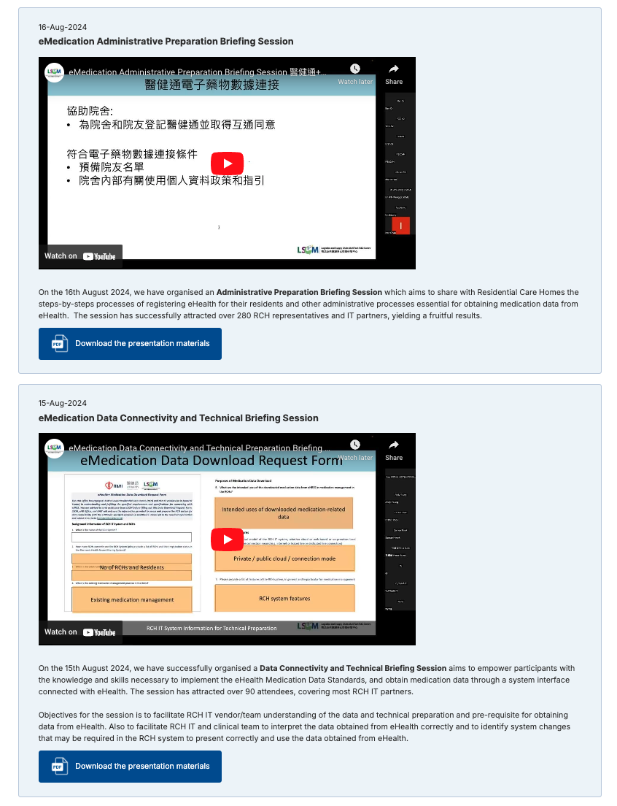


eHealth eMedication Connectivity Preparation
Kick-off Meeting for eMedication 25 Mar 2024
Technical and Data Preparation 15 Aug 2024
Administrative Preparation 16 Aug 2024
IT Security Preparation 30 Sep 2024
Data Preparation (Advanced) and iAm Smart Authentication 4 Oct 2024
Security Penetration Test preparation Online Session 14 Nov 2024
https://emedication.lscm.hk/

Slide 3
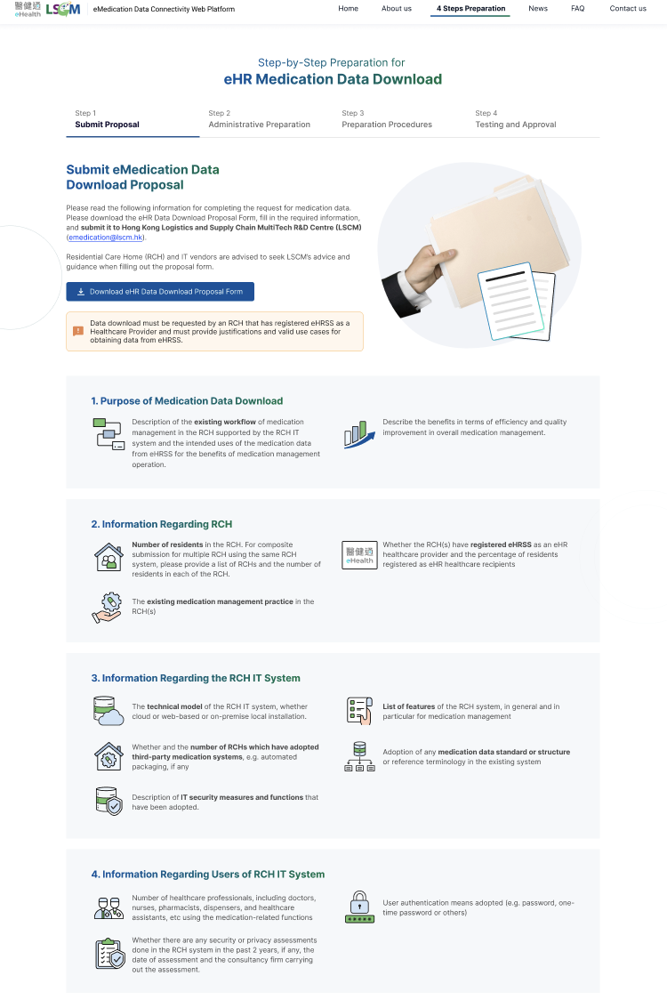
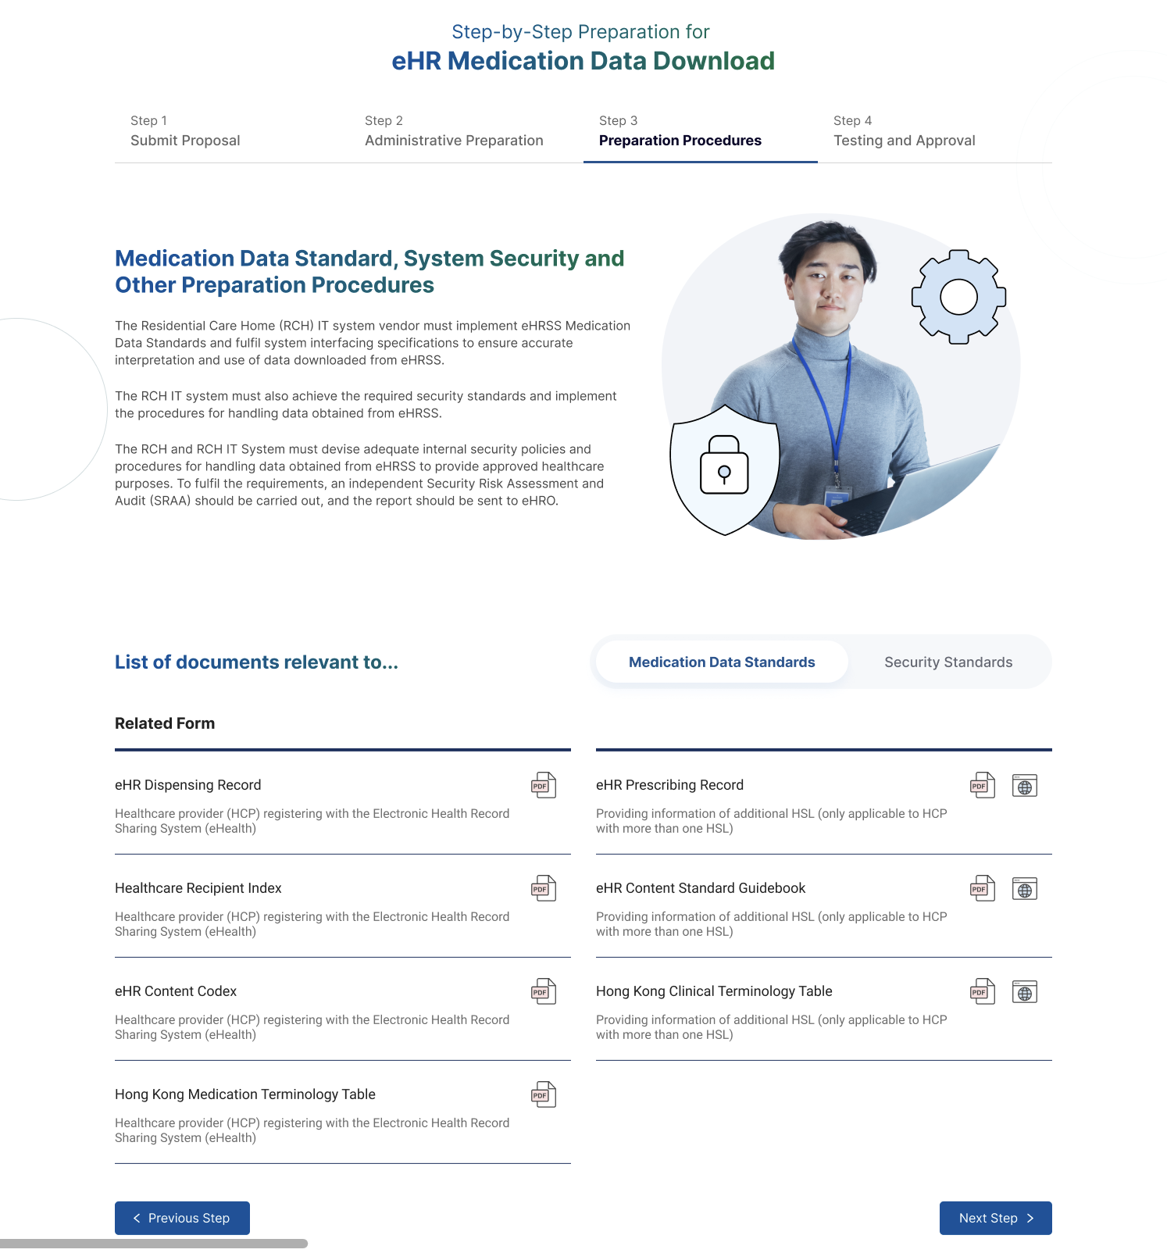
LSCM eMedication Connectivity Platform
Portal for all relevant forms, requirements and specifications and links to eHealth.gov.hk

Slide 4
Step-by-Step Preparation for Data Downloading
1. Request
2. Administrative Preparation
3. Technical Preparation
4. Testing and Approval
Submit request
Submit RCH list
1. eHR Registration
HCP
HCR
Sharing / Download
2. Privacy Polices and Procedures
PIA
1. Data Standards (HKCTT/HKMTT)
2. Interfacing Standards (HL7 FHIR)
3. Security
Security Checklist
SRAA
1. Data and Integration Tests
2. Formal approval by eHRO

Slide 5
Agenda
⁠⁠Scope and format of security penetration test by Security Consultant
⁠⁠Preparation by RCH IT systems and schedule of work

